Slide 1
Sales Prediction and Success Classification of Furniture Products
A Machine Learning Project Using E-commerce Dataset
Name – ABDULLAH MD SHAMIM
UNID: UMID17052536986
DATA SCIENCE INTERN
UNIFIED MENTORS

Slide 2
OBJECTIVE:
Predict whether a product is a High Seller or Low Seller
Use features: product title, price, and shipping type
Help businesses identify potential bestsellers in advance

Slide 3
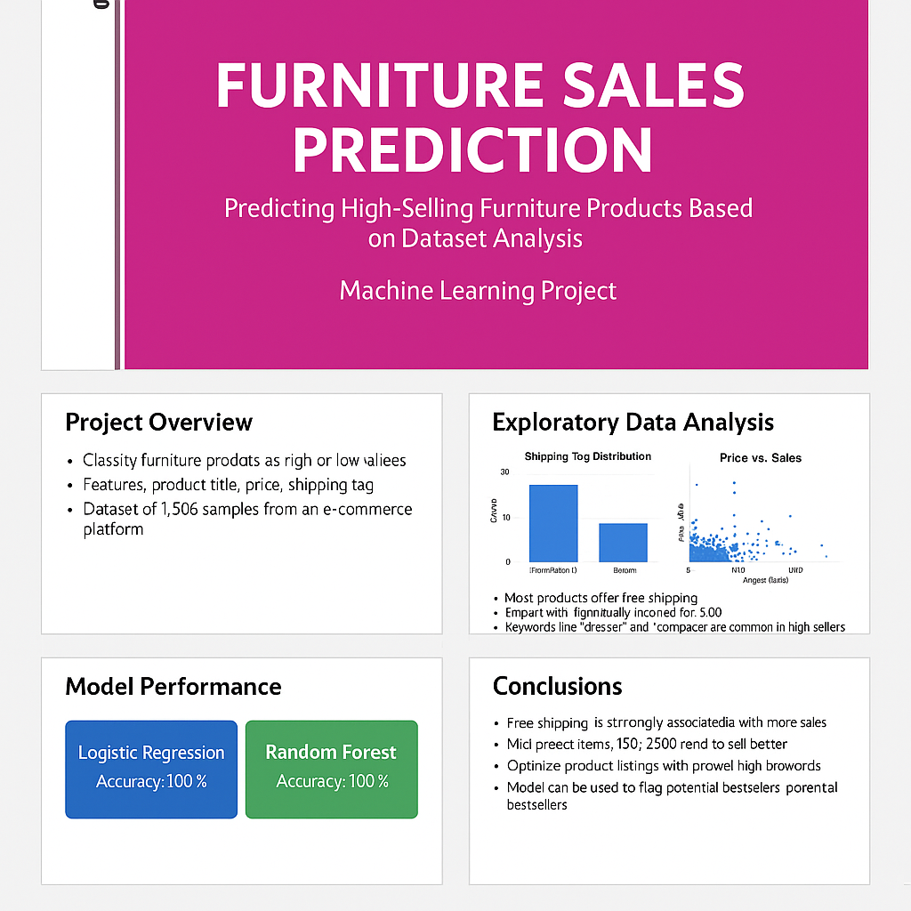

Slide 4
Slide 3: Dataset Overview
2,000 product listings from a furniture e-commerce platform
Features: productTitle, price, originalPrice, tagText, sold
After cleaning: 1,906 rows

Slide 5
Data Cleaning & Preparation
Dropped duplicates (94) and missing values
Converted price from string to numeric
Removed unusable column 'originalPrice'
Encoded 'tagText'

Slide 6
Target Creation
New column: HighSeller
Label = 1 if sold >= 10, else 0
Converted regression to classification task

Slide 7
Exploratory Data Analysis (EDA)
Most products offer Free Shipping
High sellers mostly priced $40–$120
Word Cloud shows "modern", "wood", "drawer" dominate

Slide 8
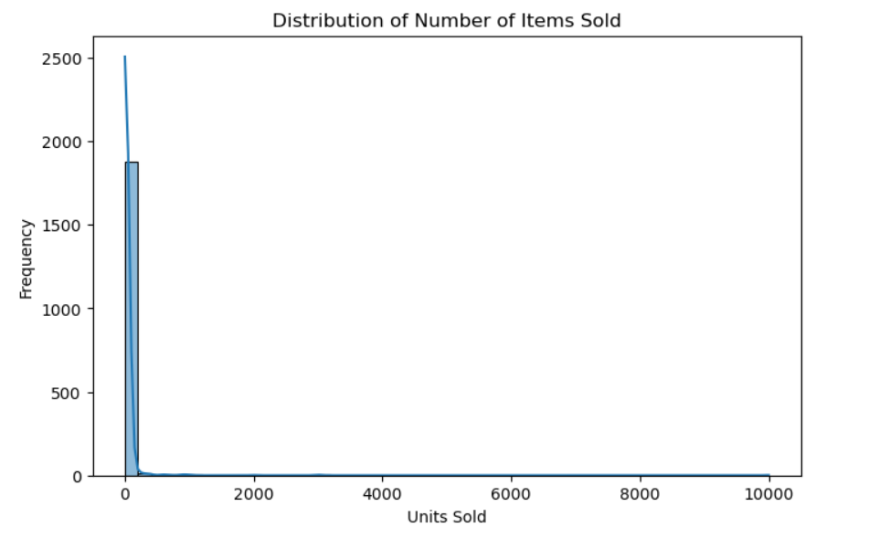
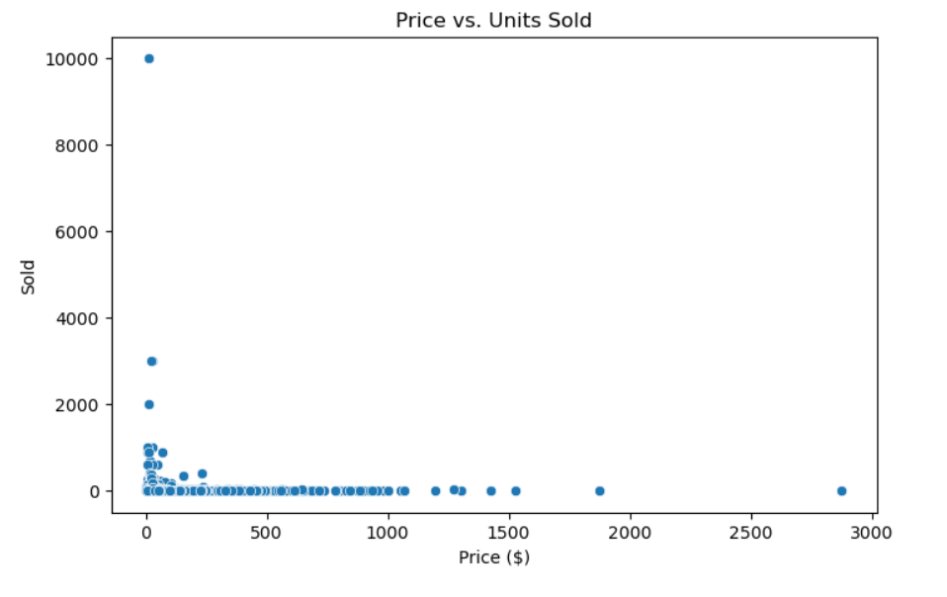
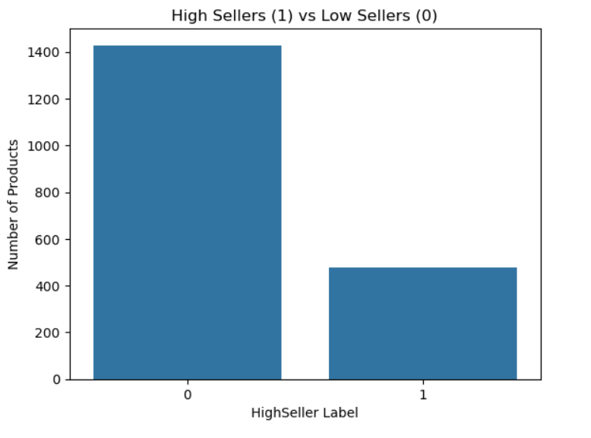
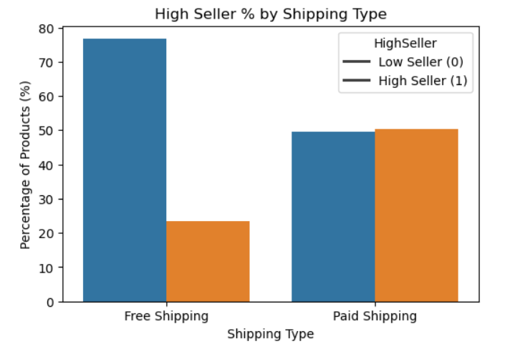

Slide 9
Feature Engineering
Applied TF-IDF to 'productTitle' (top 100 words)
Encoded 'tagText' (Free shipping -> 0 or 1)
Final dataset fully numeric and model-ready

Slide 10
Model Building
Train-Test Split: 80% train, 20% test
Algorithms used:
Logistic Regression
Random Forest Classifier

Slide 11
Model Evaluation Results
Both models achieved:
Accuracy: 100%
Precision, Recall, F1-score: 1.00
Confusion Matrix: 0 errors

Slide 12
Business Insights
Free shipping boosts sales probability
Price bands ($40–120) have best-performing products
Title keywords like "modern", "storage" influence performance
Predictive tagging helps flag future bestsellers

Slide 13
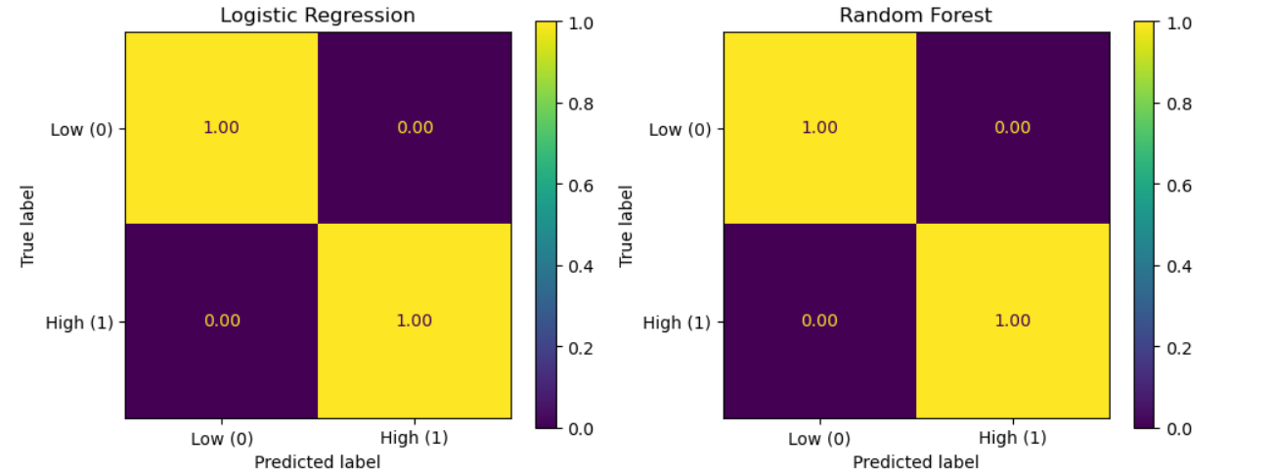

Slide 14
Conclusion
Simple features like price, title, and shipping can predict sales success
Useful for businesses to plan promotions, pricing, and SEO
Project shows ML can support product strategy in e-commerce

Slide 15
Contact Info:
Name: Abdullah Md Shamim
Email: abdullahshamim7584@gmail.com
LinkedIn: https://www.linkedin.com/in/abdullah-shamim-497ba434a/

